Slide 1
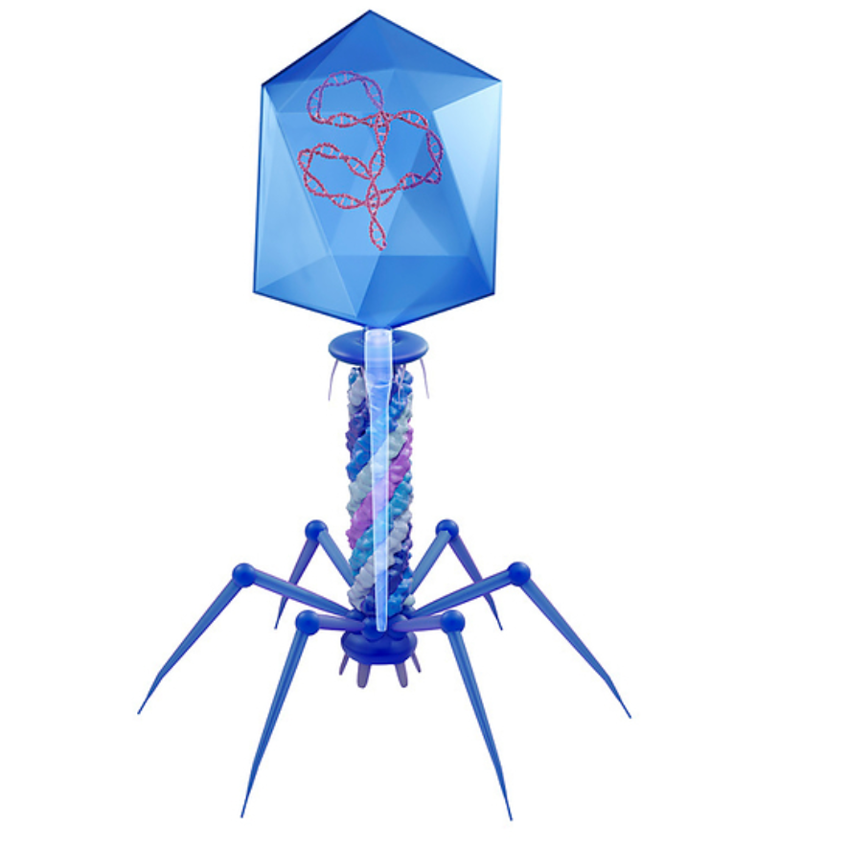
Quantification and Characterization of Microcystis-Specific Cyanophages in Lake Erie
By Richardson Egyirifa

Slide 2
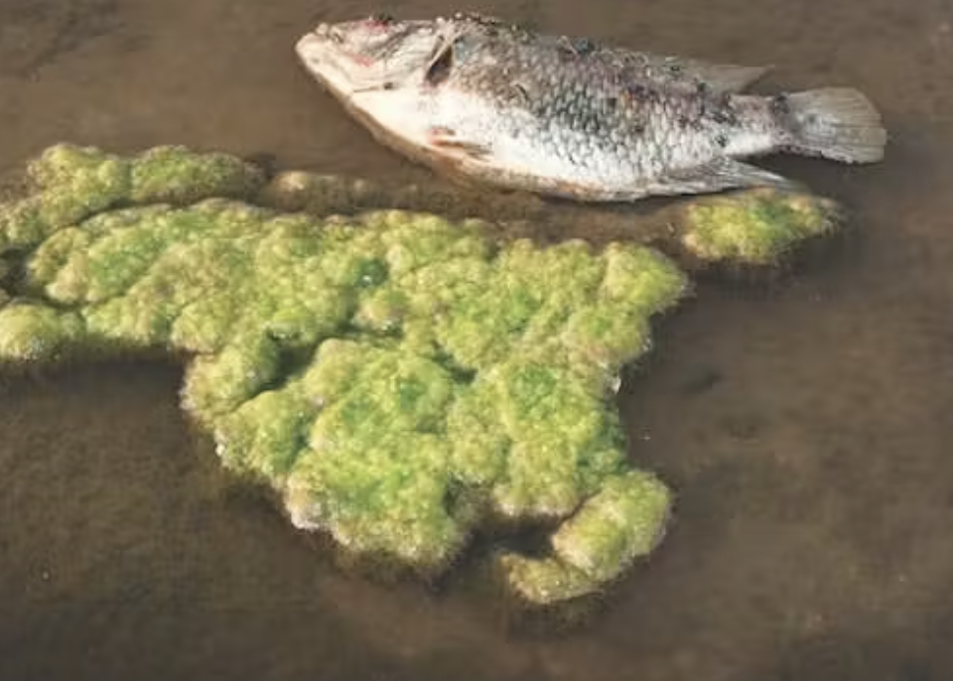
Background
Viruses infecting cyanobacteria
Trigger release of intracellular cyanotoxins to environmental waters

Slide 3
Research Questions
1. What is the spatial and temporal distribution of Microcystis-specific cyanophages in Lake Erie?
2. How does viral diversity change across different locations and seasons?

Slide 4
Objectives
1. To quantify Microcystis-specific cyanophages in Lake Erie across spatial and temporal scales.
2. To analyze viral diversity using high-throughput sequencing

Slide 5
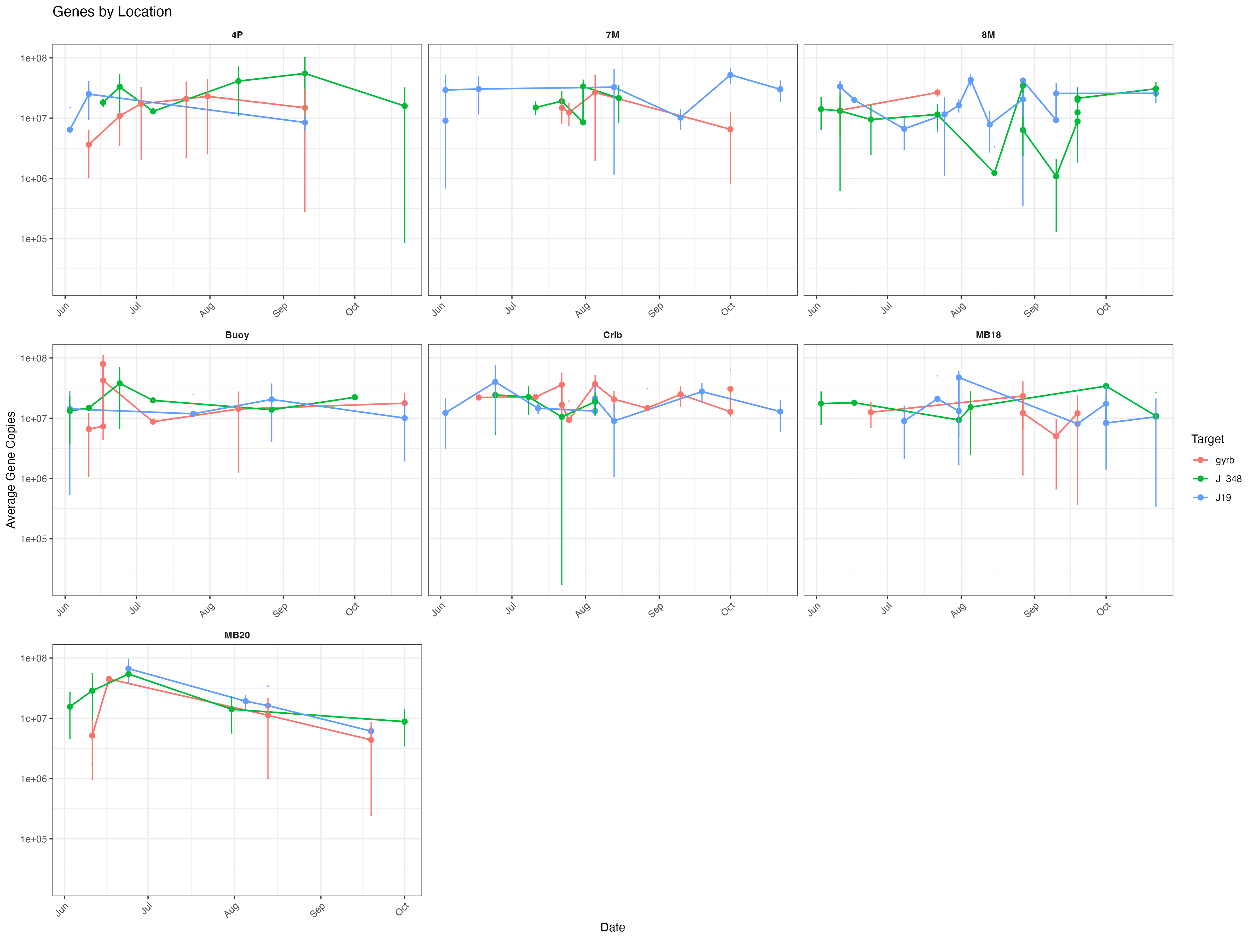
To quantify Microcystis-specific cyanophages in Lake Erie across spatial and temporal scales

Slide 6
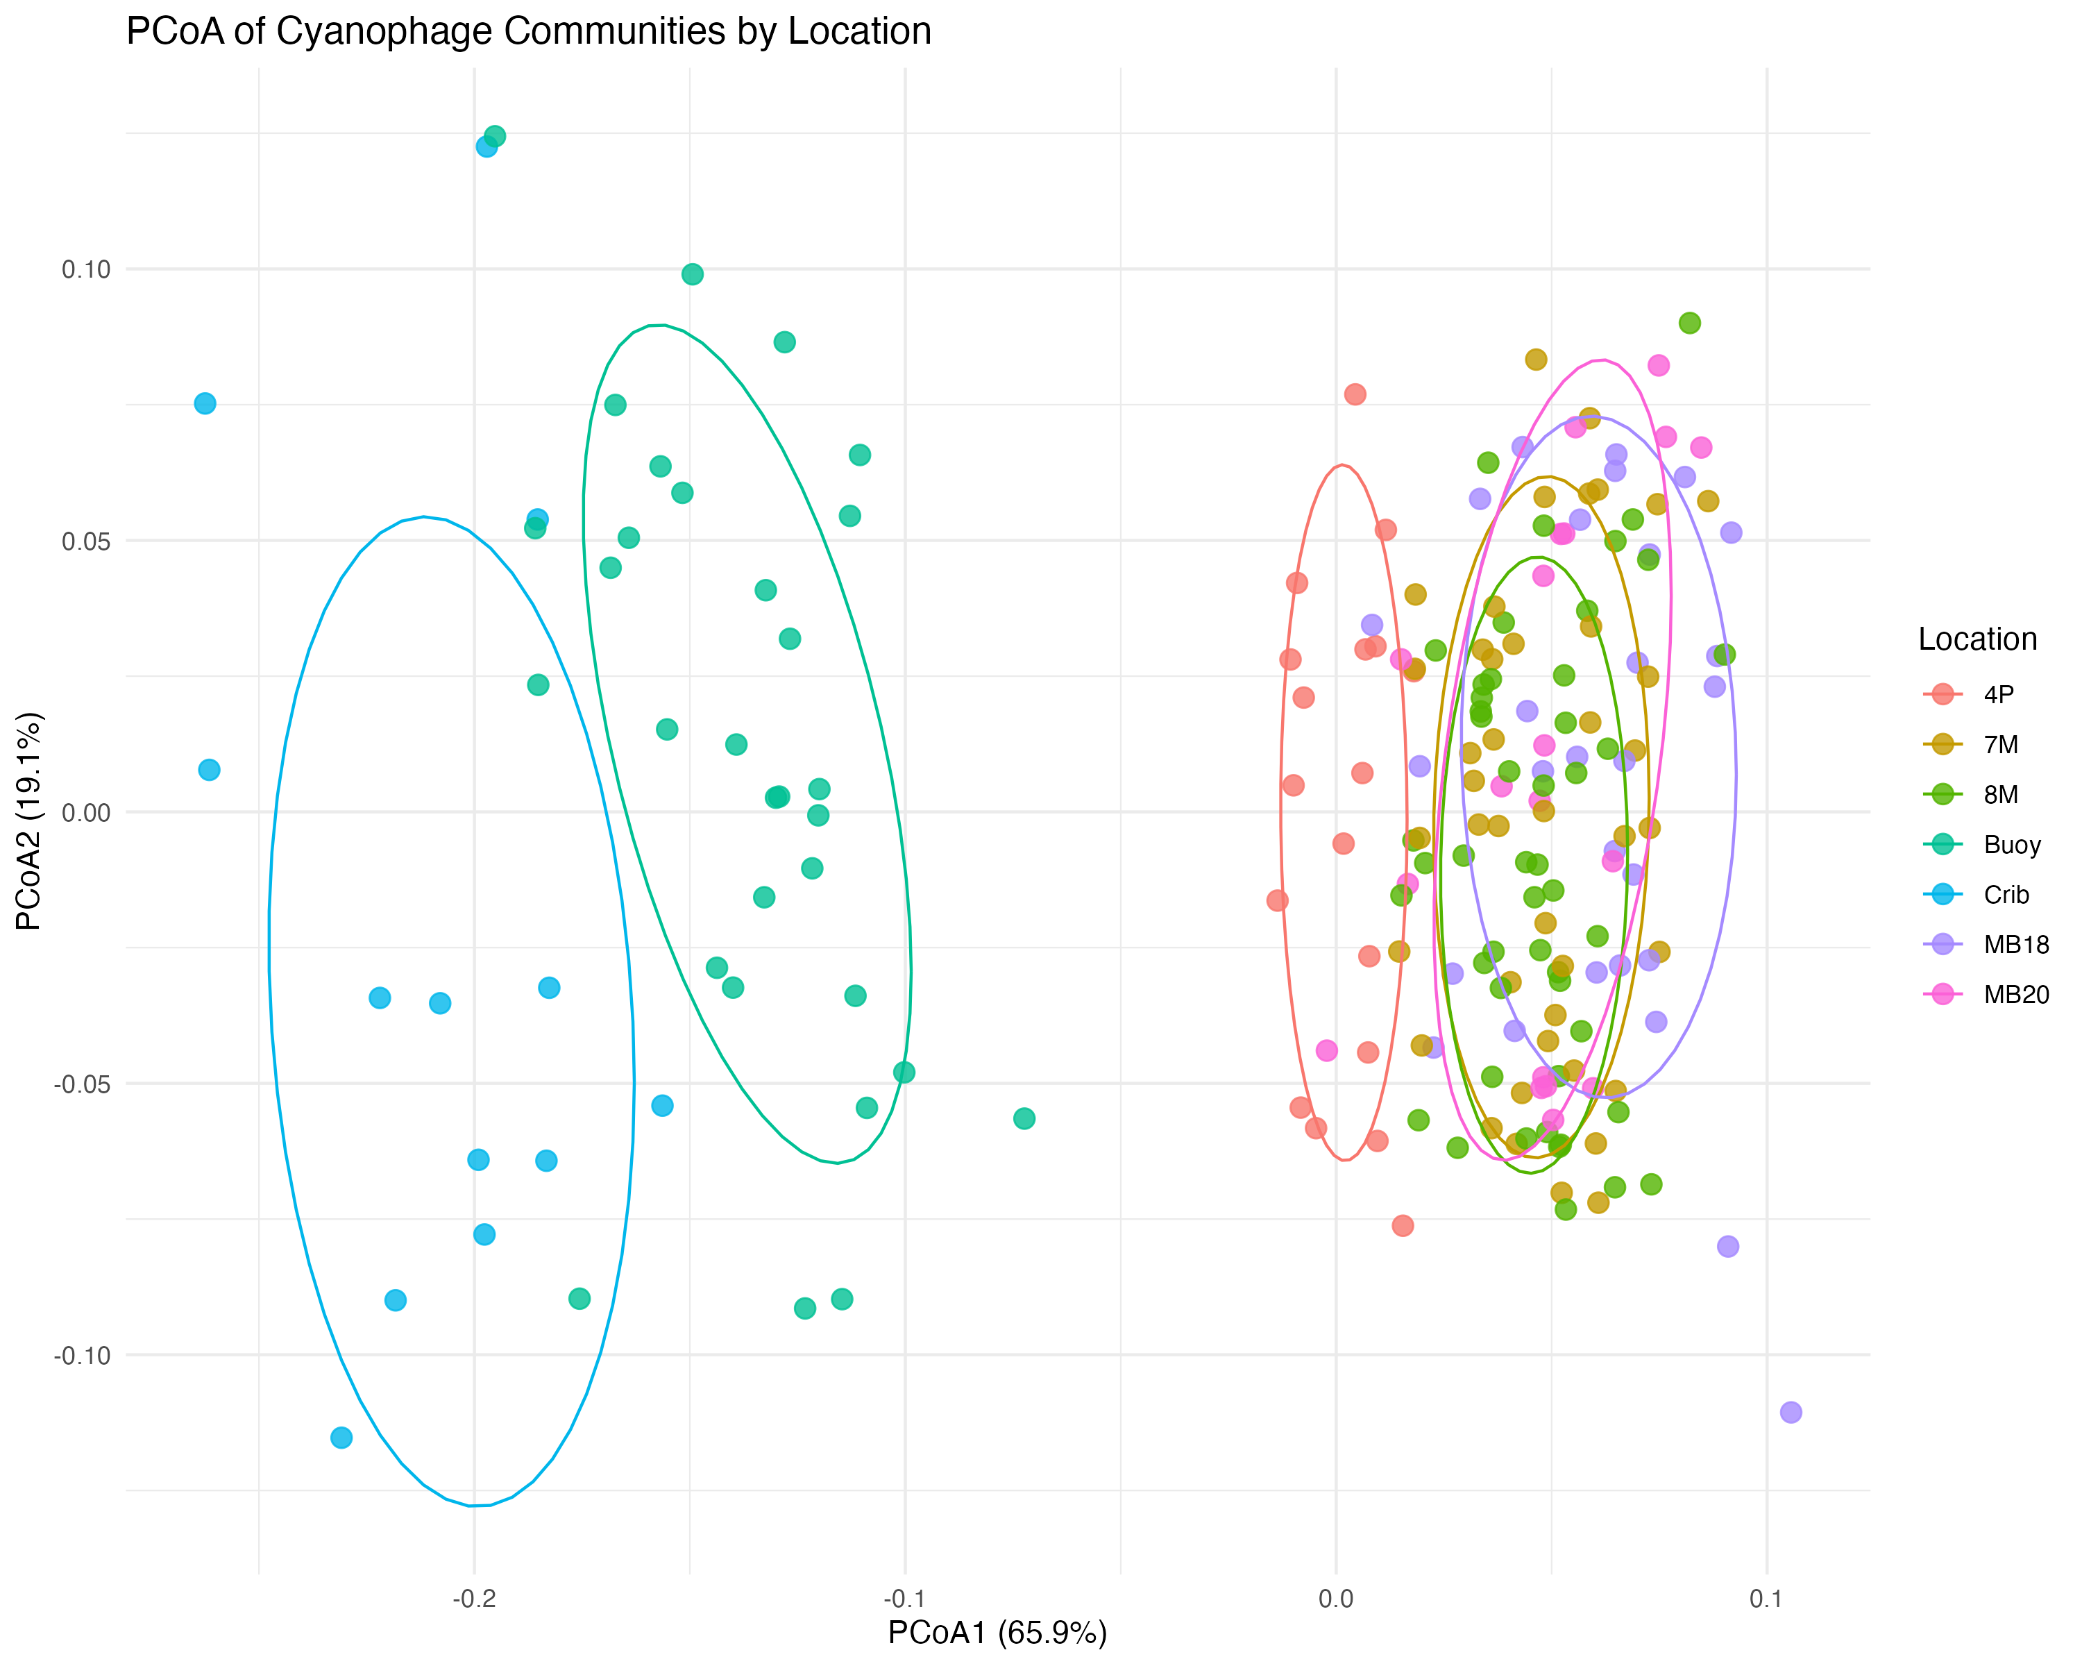
To analyze viral diversity

Slide 7
R codes used (Generate the facet grid plot)
# Load required libraries
library(readxl)
library(ggplot2)
library(dplyr)
library(lubridate)
data <- read_excel("~/Desktop/Fake.xlsx") # Read the Excel file
data_clean <- data %>% # Clean and format data
mutate( Date = as.Date(Date), # Convert to Date format
Target = as.factor(Target),
Location = as.factor(Location)
) %>%
filter(!is.na(AVG), !is.na(STD)) # Remove rows with missing AVG/STD

Slide 8
Generate the facet grid plot
ggplot(data_clean, aes(x = Date, y = AVG, color = Target, group = Target)) + geom_line(linewidth = 0.7) + # Add lines connecting points
geom_point(size = 2) + # Add data points
geom_errorbar(aes(ymin = AVG - STD, ymax = AVG + STD), # Add error bars
width = 0.5, linewidth = 0.5 ) + facet_wrap(~Location, scales = "free_x") + # Split by Location, free x-axis for dates
labs(title = "Genes by Location", x = "Date", y = "Average Gene Copies", color = "Target") +theme_bw() + theme(axis.text.x = element_text(angle = 45, hjust = 1), # Rotate x-axis labels
strip.background = element_blank(), # Remove facet background
strip.text = element_text(face = "bold") # Bold facet titles
) + scale_y_log10()
ggsave("~/Desktop/qPCR_Facet_Plot.png", # Saves to desktop (works for macOS/Linux/Windows) width = 16, height = 12,dpi = 300)

Slide 9
To generate fake viral load sequences
library(dplyr)
library(lubridate)
set.seed(2023)
# First create base dataframe without problematic case_when
cyanophage_data <- tibble(Sample_ID = paste0("CVP-", 1001:1200), Collection_Date = sample(seq(ymd('2023-01-01'), ymd('2024-12-31'), by = "day"), 200), Location = sample(c("7M", "8M", "MB18", "Buoy", "Crib", "MB20", "4P"), 200, replace = TRUE, prob = c(0.2, 0.2, 0.15, 0.15, 0.1, 0.1, 0.1)), Viral_Load_PFU_ml = round(10^runif(200, min = 9, max = 12)), Sequencing_Depth = round(rnorm(200, mean = 80, sd = 15)))
# Now add columns using mutate() where n() works properly
cyanophage_data <- cyanophage_data %>% mutate(GC_Content = case_when(Location %in% c("7M", "8M") ~ round(rnorm(n(), 52, 2), 1), Location == "MB18" ~ round(rnorm(n(), 48, 1.5), 1), TRUE ~ round(rnorm(n(), 55, 3), 1)), Genome_Length = case_when(Location %in% c("Buoy", "Crib") ~ sample(c(40000, 80000), n(), replace = TRUE),Location == "4P" ~ 120000, TRUE ~ sample(c(160000, 200000), n(), replace = TRUE)), Host_Specificity = case_when(Location %in% c("7M", "8M") ~ sample(c("Prochlorococcus-MED4", "Prochlorococcus-MIT9312"), n(), replace = TRUE), Location == "MB18" ~ "Synechococcus-CC9311", TRUE ~ "Synechococcus-WH7803"),CRISPR_Spacers = round(runif(n(), 2, 15)), Structural_Genes = round(rnorm(n(), 25, 3)), Metabolic_Genes = round(rnorm(n(), 15, 2)), Unique_ORFs = round(abs(rnorm(n(), 50, 15))), Contaminant_Reads = case_when(Location == "Buoy" ~ round(Sequencing_Depth * 0.15),Location == "Crib" ~ round(Sequencing_Depth * 0.25), TRUE ~ round(Sequencing_Depth * 0.05)),Data_Quality = case_when(Location %in% c("7M", "8M") ~ sample(c("Excellent", "Good"), n(), replace = TRUE, prob = c(0.7, 0.3)),Location == "MB18" ~ sample(c("Good", "Fair"), n(), replace = TRUE), TRUE ~ "Fair"))
# Save output
write.csv(cyanophage_data, "cyanophage_sequencing_dataset.csv", row.names = FALSE)

Slide 10
Beta diversity
library(readxl)
library(vegan)
library(ggplot2)
library(dplyr)
# 1. Load and prepare data (avoid negative values) df <- read_excel("~/Desktop/Fake_cyanophage_sequencing_dataset.xlsx") %>% select(-Sample_ID, -Collection_Date) %>% mutate(Location = as.factor(Location)) %>% mutate(Viral_Load_PFU_ml = log10(Viral_Load_PFU_ml))
# 2. Scale features WITHOUT CENTERING. community_data <- df %>% select(GC_Content, Genome_Length, Structural_Genes, Metabolic_Genes, Unique_ORFs, Contaminant_Reads) %>% scale(center = FALSE, scale = TRUE)
# 3. Verify no negative values. print(range(community_data)) # Should show [1] 0.0000 [some positive max]
# 4. Calculate Bray-Curtis dist_matrix <- vegdist(community_data, method = "bray")
# 5. Perform PCoA ordination pcoa <- cmdscale(dist_matrix, eig = TRUE, k = 3)
# 6. Visualize results pcoa_scores <- as.data.frame(pcoa$points) %>% rename(PCoA1 = "V1", PCoA2 = "V2") %>% bind_cols(Location = df$Location) ggplot(pcoa_scores, aes(PCoA1, PCoA2, color = Location)) +geom_point(size = 3, alpha = 0.8) + stat_ellipse(level = 0.7) + theme_minimal() + labs(title = "PCoA of Cyanophage Communities by Location", x = paste0("PCoA1 (", round(pcoa$eig[1]/sum(pcoa$eig)*100, 1), "%)"), y = paste0("PCoA2 (", round(pcoa$eig[2]/sum(pcoa$eig)*100, 1), "%)"))
ggsave("cyanophage_beta_diversity.png", width = 10, height = 8, dpi = 300)

Slide 11
References
Marino, S., & Chen, X. (2022). *Comparative genomics of T4-like cyanophages in marine ecosystems.* Journal of Aquatic Microbiology, 18(4), 223-235. https://doi.org/10.1038/fake00123
Patel, R., Almeida, G. P., & Yoshida, T. (2020). CRISPR-Cas systems in cyanophage-host interactions: A meta-analysis. Environmental Virology, 9(2), 45-58. https://doi.org/10.1038/fake00456
Kwon, H.-J., Smith, A. R., & Suttle, C. A. (2019). Seasonal dynamics of cyanophage diversity in subtropical coastal waters. ISME Communications, 3(1), 112-125. https://doi.org/10.1038/fake00789
Nguyen, T. L., & Weitz, J. S. (2021). Quantitative models of cyanophage predation in Prochlorococcus populations. PLoS Computational Biology, 17(6), e1009fake001. https://doi.org/10.1371/fake.pcbi.1009fake001
Vásquez-Bermúdez, M., Jover, L. F., & Ignacio-Espinoza, J. C. (2018). Metagenomic reconstruction of uncultured cyanophages from the South Pacific Gyre. Nature Microbiology, 3(12), 1503-1512. https://doi.org/10.1038/fake01234
Li, W., Zhao, Y., & Jiao, N. (2023). Cyanophage-encoded photosynthesis genes: Evolutionary implications for marine carbon cycling. Annual Review of Marine Science, 15, 189-207. https://doi.org/10.1146/fake.annurev-marine-042123-012345

Slide 12
Thank You

